Slide 1
Determining the amount of warm zodiacal dust in the habitable zones of nearby solar-type stars
W. C. Danchi, NASA/GSFC
2 August 2015
Townes Symposium, Berkeley, CA

Slide 2
Outline
The ExoZodi problem
HOSTs survey
LBTI instrument
Recent results

Slide 3
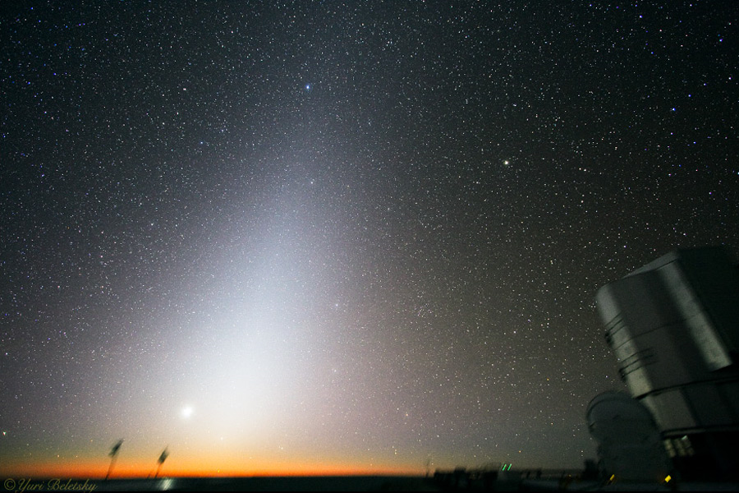
Zodi, Debris Disks, and Exozodis are related and are affected by planets
Zodiacal light as viewed from the VLT in Chile.
An exozodi is the warm component of a debris disk in the habitable zone, similar to our zodiacal cloud.
Cold debris disks (i.e., Edgeworth-Kuiper Belts) have been detected around about 25% of nearby FGK stars with Herschel (Eiroa et al. 2012) using PACS at 70, 100, and 160 microns from excesses observed in SEDs.
Debris disks and exoplanets interact with each other. Debris disks are sculpted by exoplanets, e.g., like β Pic.

Slide 4


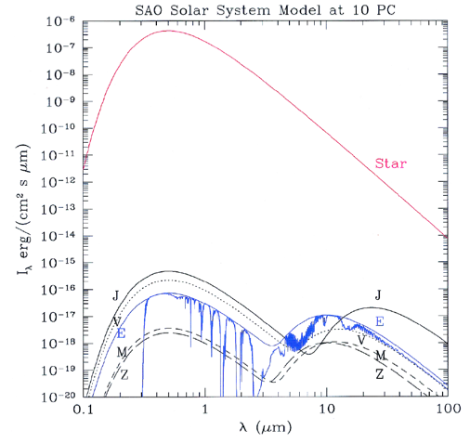
The Contrast Problem
Planet Finding missions aim to:
detect Earths 10⁻¹⁰ fainter in visible.
detect Earth 10⁻⁷ in the IR.
Current state of the art:
Fomalhaut b: 10⁻⁹, but 150x separation.
HR 8799b: 10⁻⁴ but 17x separation.
10¹⁰
HR 8799 b
α = 1.7”
Our own Zodiacal dust:
5x 10⁻⁵ at 10 µm =1 zodi.
Fomalhaut b
α = 15”
10⁷
Exozodiacal dust becomes a problem:
10 zodi or above.
LBTI can show us what exists (planets or dust disks) at faint levels around nearby stars.

Slide 5
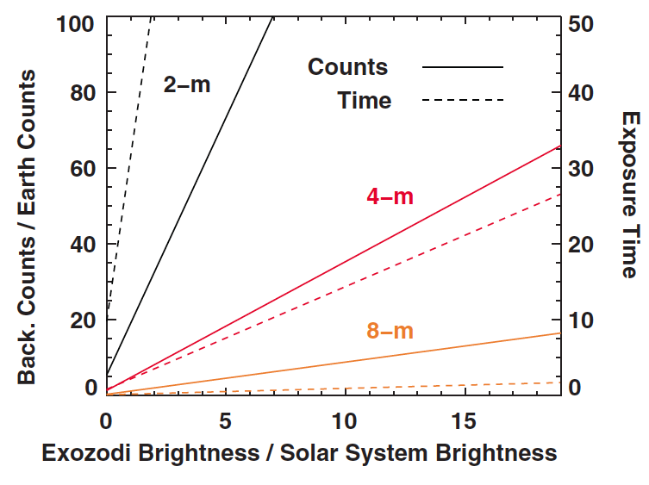
Exozodi matters for exposure time
t_{exp} ≈ D⁻⁴ * zodi
See Roberge et al. (2012) for detailed discussion.

Slide 6
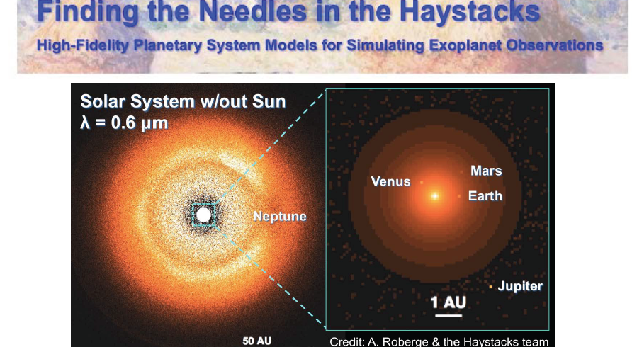
The problem: residual dust and planetesimals interfere with imaging exoplanets

Slide 7
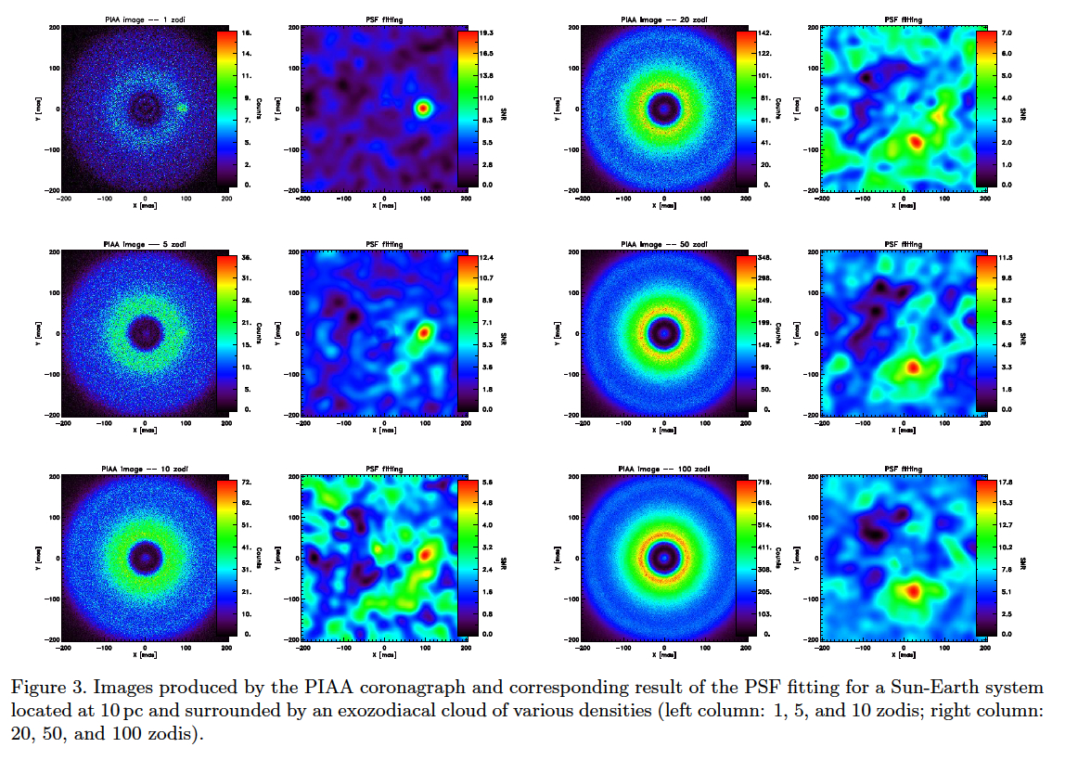
False positives of exozodi
1 zodi
20 zodi
5 zodi
50 zodi
10 zodi
100 zodi
If exo-zodi level is around 10-20x higher than in solar system, resonant dust ring structures could be brighter than an exo-Earth at 1 AU (Figure from Defrère et al. 2012)

Slide 8
Exozodi Clumps Drive Requirements of Future Exo-Earth Missions
Current simulations (Stark, Kuchner, Defrère, etc.) suggest that at the 10-20 zodi level, dust clumps could outshine the reflected signal of an Earth-like planet and be very close to it, creating a major source of confusion and false positives for a future mission
  The exact brightness and location of these clumps will be stellar system specific (function of Mp, ap, rdust)
In order to properly assess this risk, the median exozodi level should be measured down to a fraction of this 10-20 zodi confusion threshold
This “confusion uncertainty” (bright clumps) issue is likely more important than the sensitivity uncertainty, and should drive the LBTI performance requirement

Slide 9
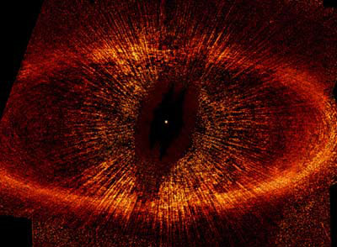
The Observing Challenge
High contrast: zodiacal dust to Sun contrast = 5 × 10⁻⁵ at 10 μm;
Small angular separation: 100 mas for an Solar system located at 10 pc;
Require IR-interferometry to be resolved;
  14.4-m baseline => 70 mas at 10 μm;
  Nulling to improve the contrast;
?
40 K
?
300-600K

Slide 10
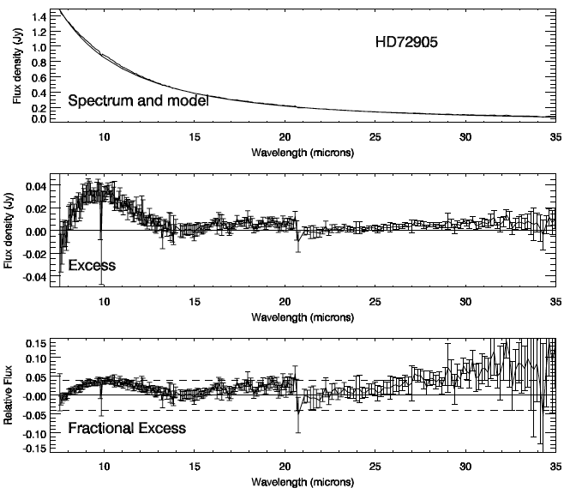
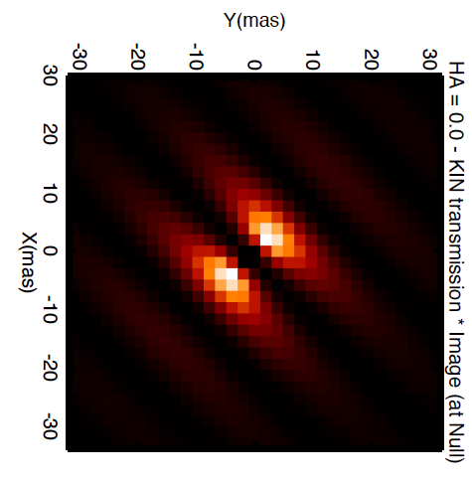
Exozodis are difficult to detect
The dust emission is faint and close to the star.
Unresolved photometry is the most common method.
Even with infinite photometric accuracy, limited to ~1% best case relative photometry by ability to predict the stellar MIR flux (~300 zodi, 1σ).
Spitzer/IRS – Beichman et al. 2006
Interferometry helps
2σ stellar model uncertainty
Spatially separate the signal from the star and the surrounding disk.
2 main methods:
  NIR high-accuracy visibility
  (CHARA/FLOUR, VLTI/PIONIER).
  MIR Nulling (MMT/BLINC, KIN, LBTI).
Free of modeling assumptions on the stellar spectrum.
See refs. by: Ciardi, Absil, Di Folco, Defrere, Smith, Akeson, Liu, Stock, Stark, Millan-Gabet, Mennesson etc …
Notes:
IR photometry can reveal the presence of an excess emission on top of the expected stellar photospheric flux. This requires high-accuracy photometry in the MIR i.e. generally done from space (e.g. Spitzer). The intrinsic accuracy of the instruments limits the sensitivity to exozodi disks to ~ 1000 X more luminous than the Solar System zodi cloud. Even with infinite accuracy of the photometry, the technique would still be limited to an accuracy of ~1% by the capability to predict the MIR stellar photospheric flux.
HD72905 example:
Bottom plot dashed lines are 2sigma uncertainties due to stellar photospheric model.
Fdust/Fstar = 0.05 max
Ldust/Lstar = 1e-4 => 1000z.
Other Data Examples (Beichman 2006, Lawler 2009):
Spitzer/MIPS 70um: sensitive to excess 20-30% above star.
Spitzer/MIPS 24um: sensitive to excess 10% above star.
Spitzer/IRS 8-13um: sensitive to excess 1-3% above star. That is σ(Fdust/Fstar) = 0.01-0.03.
e.g. if all the excess came from dust at the thermal equilibrium radius for Tdust=367K (blackbody peak at 10um), these translate into Ldust/Lstar < 1.0-1.5x10^-4, which is x1000-1500 the nominal Solar value.
The second way to detect exozodi disks overcomes this limitation by angularly separating the signal from the star from its surrounding disk.
The required angular resolution can be achieved with IR interferometers.
2 types are contributing to exozodi surveys: high-accuracy NIR interferometers (CHARA/FLOUR, VLTI/PIONIER) and MIR nullers (MMT/BLINC, KIN).

Slide 11
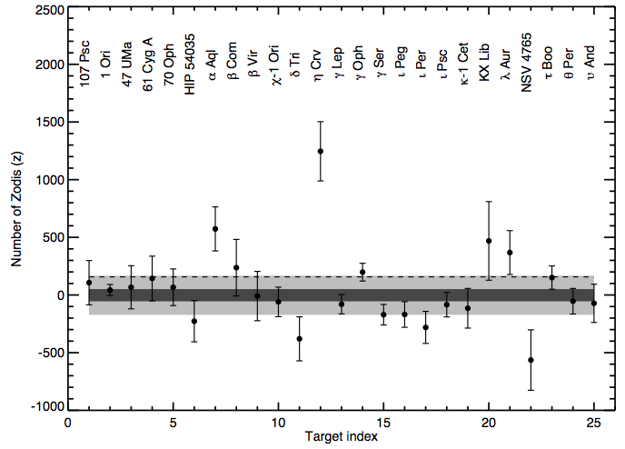
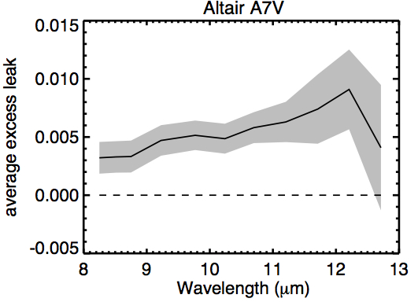
Analysis of stars with a priori no dust
(Millan-Gabet, Serabyn, Mennesson et al. 2011)
23 FGK stars.
Only one shows dust at marginal detection level (Altair – but later, NIR excess also detected by CHARA).
Mean 3σ upper limit = 570 zodi.
Population analysis: 3σ upper limit for the class = 150 zodi.
600 +/- 200 solar zodi
150 zodi 3σ upper limit for the class
Notes:
N-band fluxes: 1.3 – 4 Jy (except alp Aql = Altair 31 Jy).
Means: 3Lsun, d=10.5 pc, 3.7 Jy.
eta Crv: known to have high levels of CS dust (Spitzer/MIPS/IRS, VLTI/MIDI).
gamm Oph: known to have excess starting at 15um, and growing much larger at longer wavelengths. IR excess luminosity much larger than for eta Crv, but only marginal detection … very different zodi distributions??
alp Aql: no previously known to have CS dust. Marginal detection, ~0.8% excess leak, would be undetectable by IRAS 12um, and no 8 um measurements have been made with Spitzer.
---
Average error (160 zodi) is similar to non-detection rms (150 zodi) => errors have been fairly assigned.
---
If these stars represent a population from the point of view of warm exozodi emission; and if the measurements are uncorrelated:
mean: z = +2 ± 50.
Mean exozodi level for the class: < 150 zodi (3σ).
99.8% confidence if errors are Gaussian.
Conclusions insensitive to the shape and level of unknown underlying exozodi distribution.

Slide 12
Conclusions from KIN work
The sensitivity of current exozodi finders, 300-1000 zodi 3σ, is not adequate to assess whether exozodis in the 10–100 zodi range (problematic for direct exo-Earth detection & characterization missions from space) are common or not.
Need dedicated effort with x10 or more improvement.
Notes:
KI is now terminated for financial reasons, not technical or scientific.

Slide 13
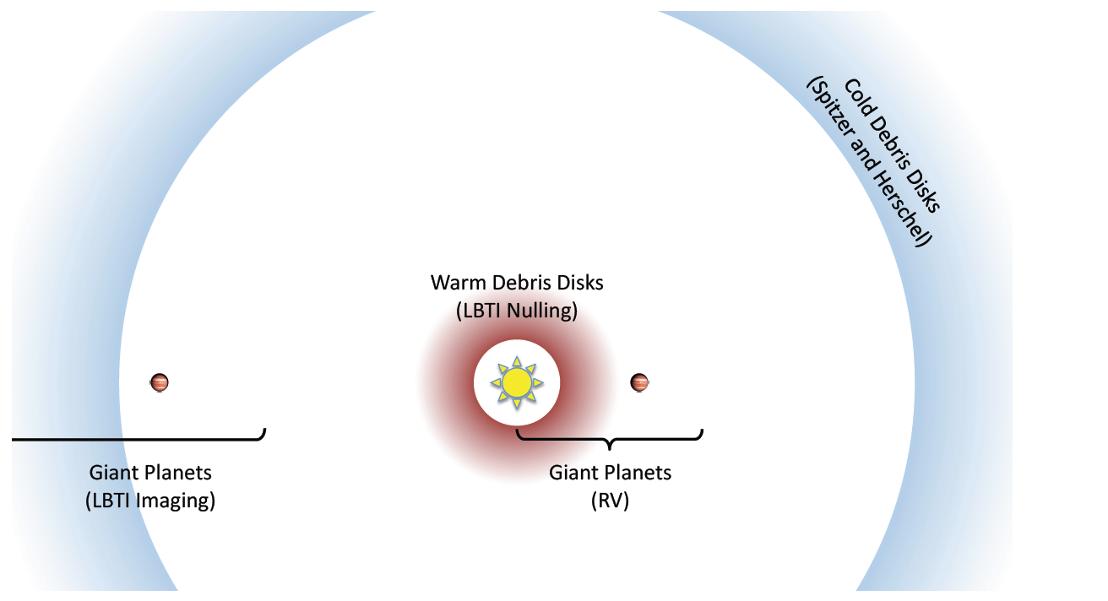
The Hunt for Observable Signatures of Terrestrial Systems
HOSTS

Slide 14
The HOSTS Program
ASTRO2010 Decadal Survey:
“… need to characterize the level of zodiacal light present so as to determine, in a statistical sense if not for individual prime targets, at what level starlight scattered from dust will hamper planet detection”.
NASA-supported 60 night survey to be carried out in the 2013-2017 time frame.
Top level goal is to reduce risk for future NASA exoplanet imaging missions
  Search actual candidate stars for exozodiacal emission.
  Understand trends and correlations for zodiacal dust
    Comparison to outer disk strength
    Dependence on age and stellar mass.
    Existence and influence of Jupiter-mass planets.

Slide 15
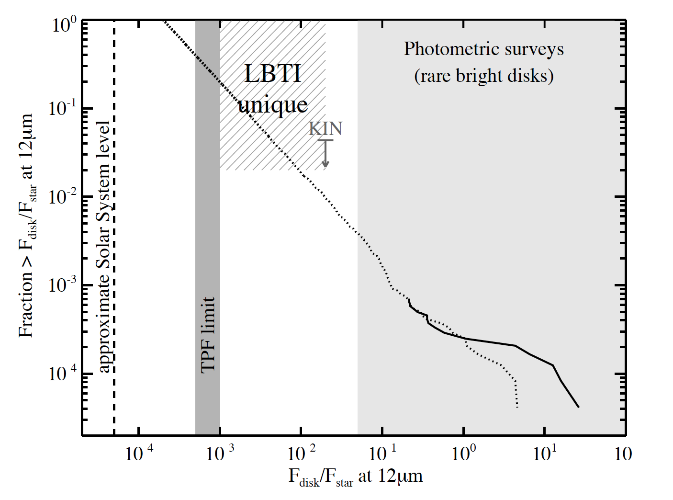
The HOSTS survey
Survey of ~50 nearby stars defined by LBTI’s science team:
    1. What is the exozodi luminosity function for nearby stars?
  2. Does the level of cold/hot dust correlate with exozodi level?
  3. How does the exozodi level vary with stellar type?
Kennedy et al. 2013
Notes:
Observed luminosity function (solid line) and a simple prediction
for faint exo-Zodi for stars between 0 and 13 Gyr with a single realization of
the combined initially massive and random collision model shown in Fig. 7
(dashed line). The grey dotted lines show the limits for LBTI and WISE
sensitivity, as well as approximate levels for the Solar system Zodiacal
cloud and for which TPF-like missions will be compromised by exo-Zodi.
The upper limit from the 23 star KIN survey is also shown (see the text).

Slide 16
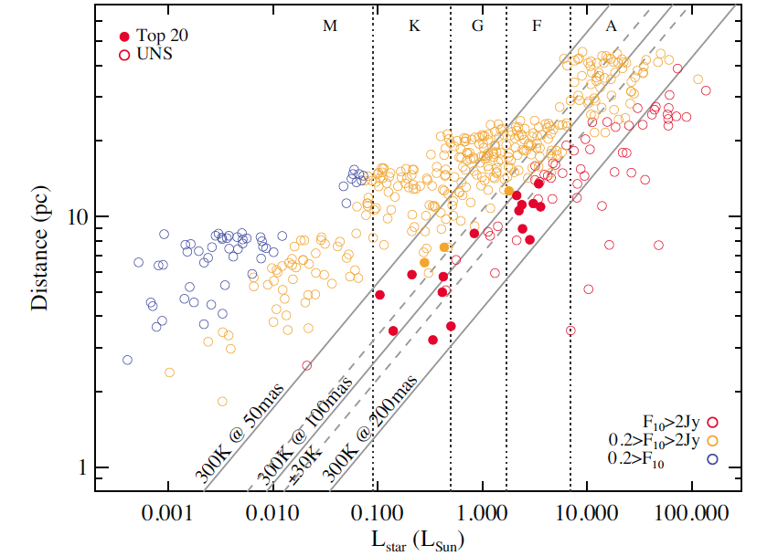
Mission Independent Target Selection
Diagonal lines show constant angular insolation distance at 300K for 50, 100, 200 mas. UNS is the Unbiased Nearby Star sample (Phillips et al. 2010).
From Weinberger et al. 2015, in press.

Slide 17
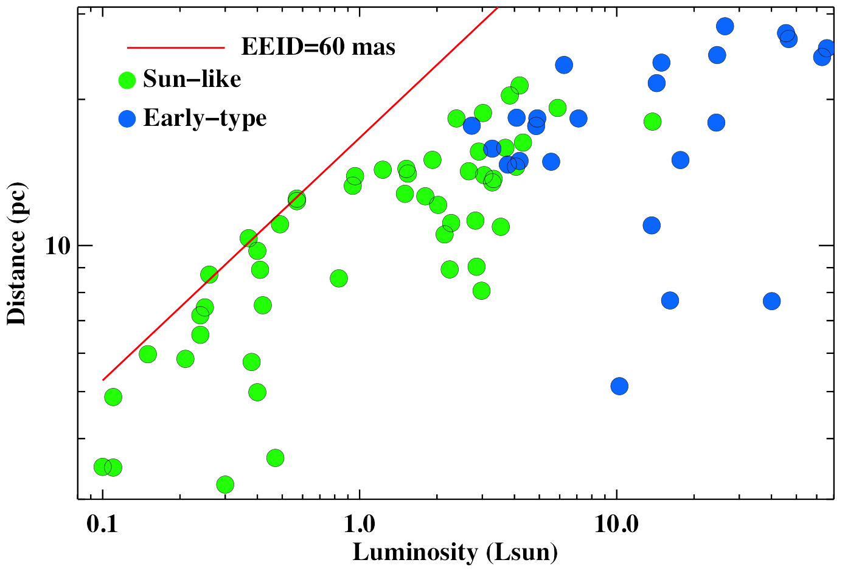
Target selection
Strategy:
  Mission Driven Selection: Observe actual stars that would be good targets for a future exoEarth direct imaging mission using star selector codes from real mission concepts (e.g., Turnbull et al. 2012) – “Sun Like Sample” – 49 stars, spectral types later than F5.
  Sensitivity Driven Selection: Observe a sample of stars for which LBTI can reach lowest zodi levels, 26 stars with spectral types A0-F4, 12 with known excesses.
Exclusions: Binaries with separation less than 1.5 arcsec, Declination > -30 degrees.
Weinberger et al. (2015)

Slide 18
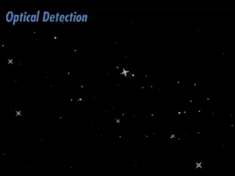
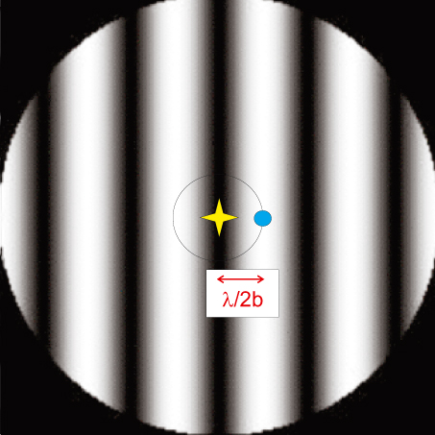
Nulling interferometry
Combining high-angular resolution and high-contrast imaging
First proposed by Bracewell (1978) to directly detect “non-Solar” planets;
Subtracting starlight by destructive interference;

Slide 19
Nulling interferometry
Combining high-angular resolution and high-contrast imaging
First proposed by Bracewell (1978) to directly detect “non-Solar” planets;
Subtracting starlight by destructive interference;

Slide 20
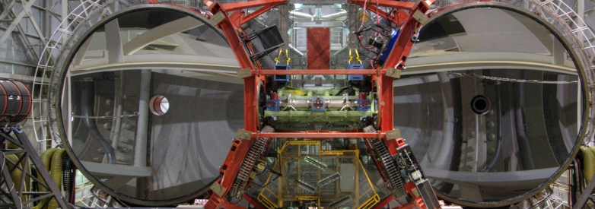
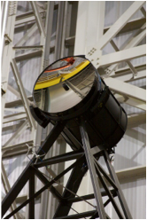
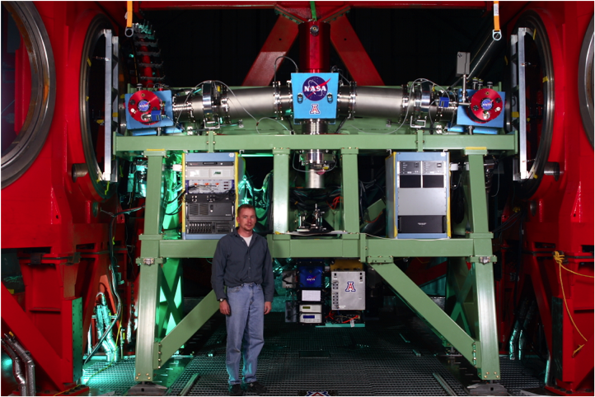
LBTI Key Parameters
Sensitivity
LBTI has two 8.4 m mirrors mounted on a single structure.
LBTI
High Contrast
The AO system creates an image with a Strehl of >95% at 3.8 μm.
LBTI installed on the telescope
LBT Deformable Secondary Mirror
Resolution
Beam combination provides the equivalent resolution of a 22.7 m telescope.

Slide 21
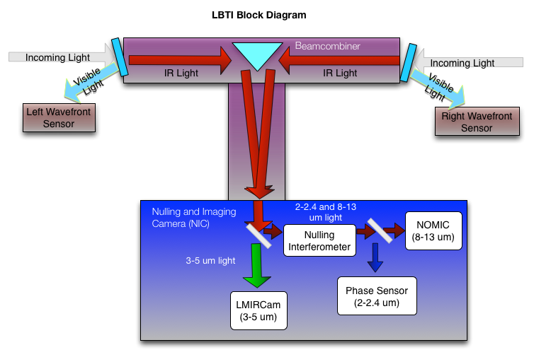
LBTI Layout

Slide 22

LBTI Cameras
 | LMIRcam | NOMIC
Wavelength Coverage (μm) | 2.9-5.1(1.5-5.1 capable) | 8-14 (8-25 capable)
Throughput | >30% | >20%
Pixel Size | 0.011” | 0.018”
FOV | 20” | 12”
Minimum Strehl | 90% (3.8 µm) | 98% (11 µm)
Spectral Resolution | 350 | 100
5 sigma detection, 1 hour | 19.0 (7 μJy) @ L’ | 13.3 (200 μJy) @ N
Spatial Resolution | 40 mas @ L’ | 100 mas @ N’
~2 MJ planet
at 1 Gyr
~1 zodi
debris disk
0.4 AU
at 10 pc
1 AU
at 10 pc

Slide 23
Nulling interferometry at LBTI
LBTI combines high-sensitivity (8.4-m diameter telescopes, cryogenic instrument) and high-resolution (14.4-m baseline)
First interferometric fringes in October 2010;
First null measurements obtained in September 2012;
First stabilized null measurements in December 2013;
Notes:
Observed luminosity function (solid line) and a simple prediction
for faint exo-Zodi for stars between 0 and 13 Gyr with a single realization of
the combined initially massive and random collision model shown in Fig. 7
(dashed line). The grey dotted lines show the limits for LBTI and WISE
sensitivity, as well as approximate levels for the Solar system Zodiacal
cloud and for which TPF-like missions will be compromised by exo-Zodi.
The upper limit from the 23 star KIN survey is also shown (see the text).

Slide 24
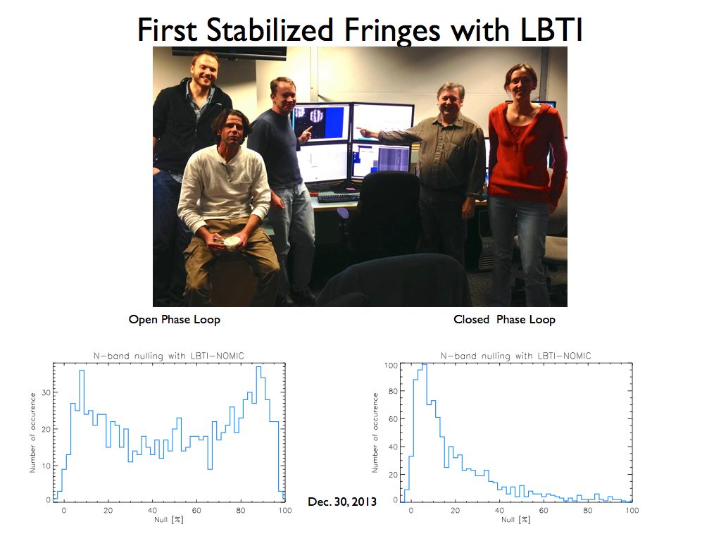
Nulling interferometry at the LBTI
First closed-loop null measurement in December 2013

Slide 25
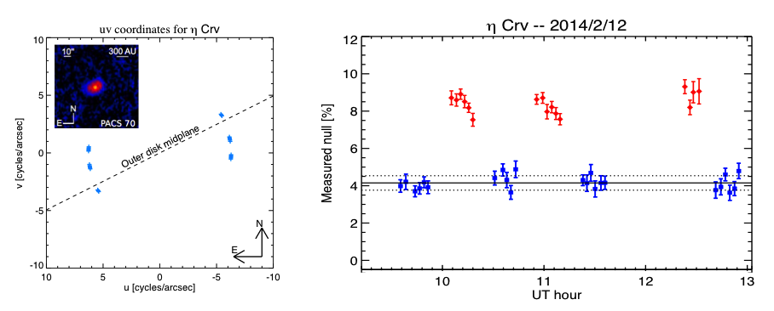
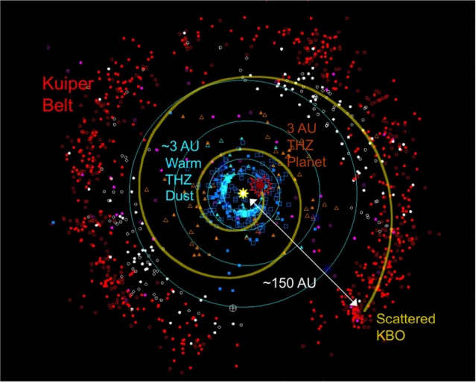

The LBTI HOSTS survey
Science goal: determine the prevalence of exozodiacal dust around nearby main-sequence stars in order to prepare future exoEarth direct imaging instruments;
Technical requirement: nulling interferometric observation at the 0.0075% level (or 3 zodis);
First science results: exozodiacal dust around η Crv closer than expected from Spitzer;
Region studied by the LBTI
First LBTI detection -- Defrère et al., ApJ 799, 2015
Spitzer view -- Lisse et al. 2012

Slide 26
LBTI survey
First-light null detection around η Crv: 4.40% +/- 0.35% (Defrère et al. 2015):

Slide 27
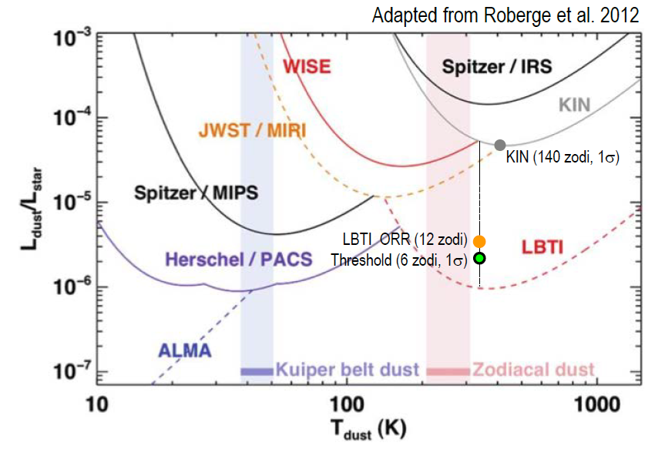
LBTI Status – Passed Operational Readiness Review in May 2015
Sensitivity limits for detection of debris dust around nearby Sun-like stars. LBTI’s current limit is 12 zodis (1σ), ~ 10-12 × that of the KIN experiment. Actual measurement error was 500 ppm (15 zodi) for a Solar-type star at 10 pc. The ORR limit (orange filled circle ) of 12 zodi (400 ppm) is based on a small extrapolation of additional observing time.

Slide 28
Summary
The LBTI project has demonstrated coherent imaging with dual AO operation.
Single aperture and non-redundant aperture mask science observations have begun with the system.
Nulling commissioning is completed and the project passed its Operational Readiness Review in late April 2015.
The HOSTS and LEECH surveys will probe for dust disks and planets starting in September 2015.

Slide 29
Recent papers -- SPIE Conference in 2014
The LBTI Hunt for Observable Signatures of Terrestrial Planetary Systems: A Key NASA Science Program on the Road to Exoplanet Imaging Missions
W. Danchi, V. Bailey, G. Bryden, D. Defrere, C. Haniff, P. Hinz, G. Kennedy, B. Mennesson, R. Millan-Gabet, G. Rieke, A. Roberge, E. Serabyn, A. Skemer, K. Stapelfeldt, A. Weinberger, M. Wyatt
Co-phasing the Large Binocular Telescope: status and performance of LBTI/PHASEcam by Defrère et al.
Commissioning the LBTI for use as a nulling interferometer and coherent imager by Hinz et al.
These papers were published in the late 2014 as part of the SPIE Proceedings of the Optical and Infrared Interferometry IV meeting held in Montreal 23-27 June 2014.

Slide 30
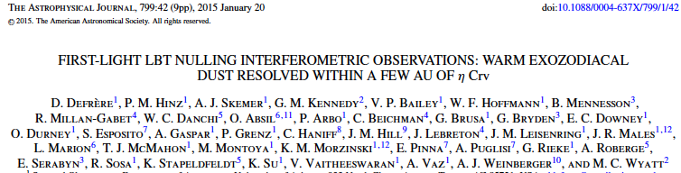
Three refereed papers published in The Astrophysical Journal in 2015
Target Selection for the LBTI Exozodi Key Science Program, Weinberger et al., accepted for publication in Astrophysical Journal Supplement Series, 2015.
Exozodi Modeling for the Large Binocular Telescope Interferometer, Kennedy et al., Astrophysical Journal Supplement Series, 2015.

Slide 31
BACKUP

Slide 32
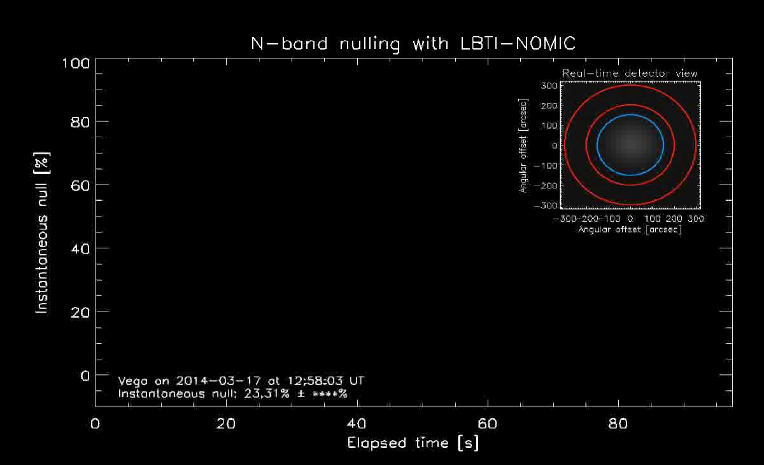
Nulling interferometry at the LBTI
First stabilized null measurements in December 2013

Slide 33
KEY Results
Like hot excesses, mid-infrared excesses are primarily detected around A stars;
But, unlike hot excesses, those A stars have all cold dust
No mid-infrared excess detected for stars with a hot excess only
Poor statistics: 34 stars of the LBTI sample not observed by near-IR interferometers
It is highly desirable to extend LBTI survey to include ALL the stars in the 68 star sample, only about ½ of sample in current plan
MATISSE instrument – 2nd generation VLTI instrument following MIDI is currently in testing in Nice, will go to Paranal in late 2015.

Slide 34
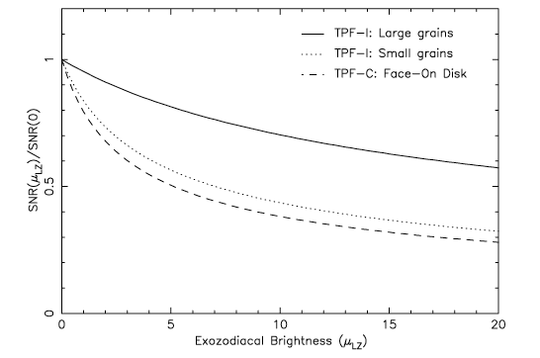
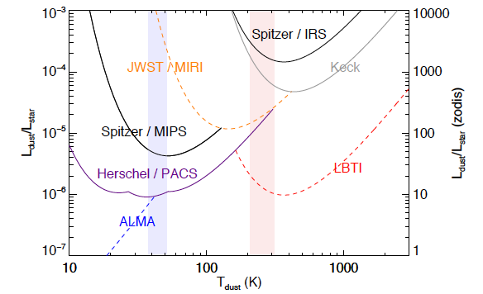
Why is NASA interested in exozodiacal dust?
Zodiacal dust around other stars can obscure flux from an Earth-twin. At 10 times our own zodiacal dust density (10 zodies) the dust will impact the performance of exo-Earth imaging missions.
LBTI is designed to probe for zodiacal dust at 10 µm down to 10 zodies. It is unique in being able to accomplish this task.
Roberge et al. NASA exoPAG report Dec. 201,
also Roberge et al. (2012, PASP)
Estimate of signal-to-noise reduction for exo-Earth
detection in the presence of increasing exozody brightness.
Comparison of current facilities’ sensitivity to exozodiacal dust. LBTI can detect dust in the habitable zone down to 10 zodies.
Beichman et al. 2006

Slide 35
The LBTI HOSTS survey
Current performance (November 2014): null calibration of 0.1% (or 40 zodis):
February 2014
March 2014
Nov 2014
3 sigmas

Slide 36
The HOSTS Team
The HOSTS team is lead by Phil Hinz, with Instrument Scientists Andrew Skemer and Denis Defrère
The NASA Exoplanet Science Center will archive data and provide data support.
An independent panel has selected astronomers from the exoplanet community to support the HOSTS program.
Kickoff meeting was in September 2012.
Monthly telecons and frequent e-mails

Slide 37
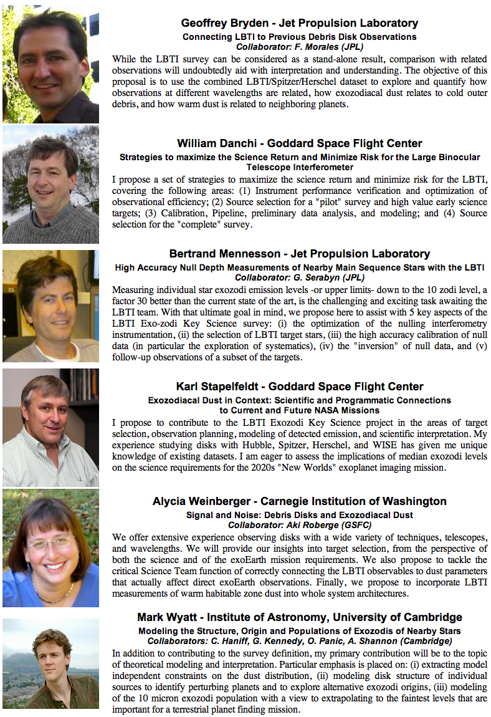
HOSTS Team Members

Slide 38
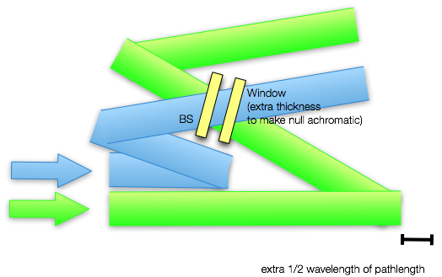
LBTI Nulling Approach
2 and 10 µm light
10 µm light
2 µm light

Slide 39
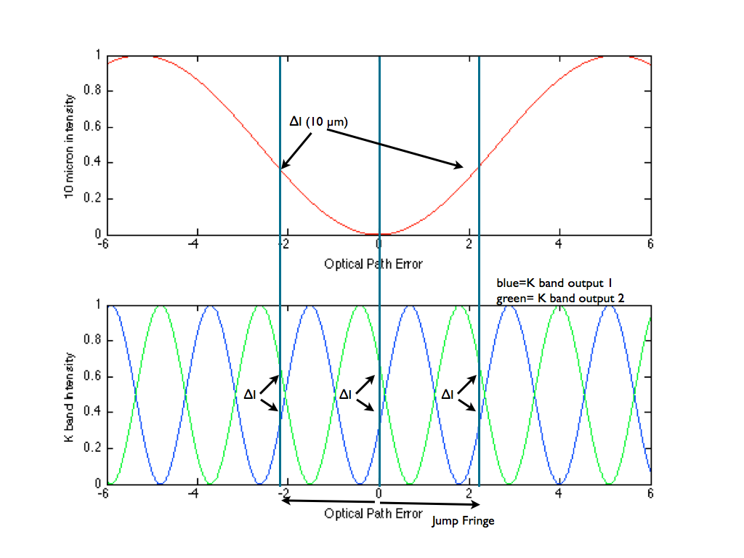
Nulling Details
Phase sensing carried out by looking at interferometric outputs at 2 microns.
Calibration of null carried out by setting the intensity difference for the phase sensor
green output
blue output

Slide 40
Preliminary Survey Plans
Three-pronged approach:
  Shallow survey of 60-80 FGKM stars
  Survey of ~10 well-known dusty systems to characterize distribution, strength, etc.
  Survey 5-10 best candidate stars for future exoplanet missions to achieve the optimal sensitivity.
Will benefit from a parallel LBTI Exozodi, Exoplanet Common Hunt (LEECH)
  L band direct imaging of system carried out via the LMIRCam on LBTI.
  Sensitive to ~Jupiter-mass planets

Slide 41
Ingredients for Master Sample List
Stars need to be:
  Bright enough and near enough to have their habitable zone resolvable by LBTI:
  Zodiacal dust above the photometric sensitivity of LBTI:
    40 pc for A stars. 21 available
    24 pc for F stars. 105 available
    14 pc for G stars. 28 available
    8 pc for K stars. 14 available
    3 pc for M stars. 2 available.

Slide 42
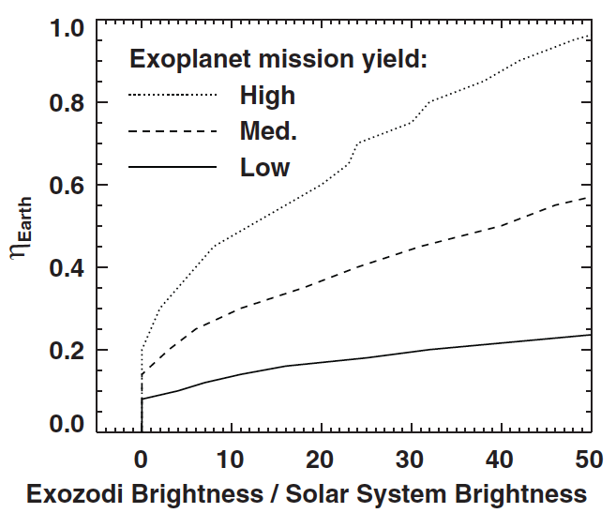
Exozodi affects mission yield, 4 m telescope, 5 year mission
From Roberge et al. (2012)

Slide 43
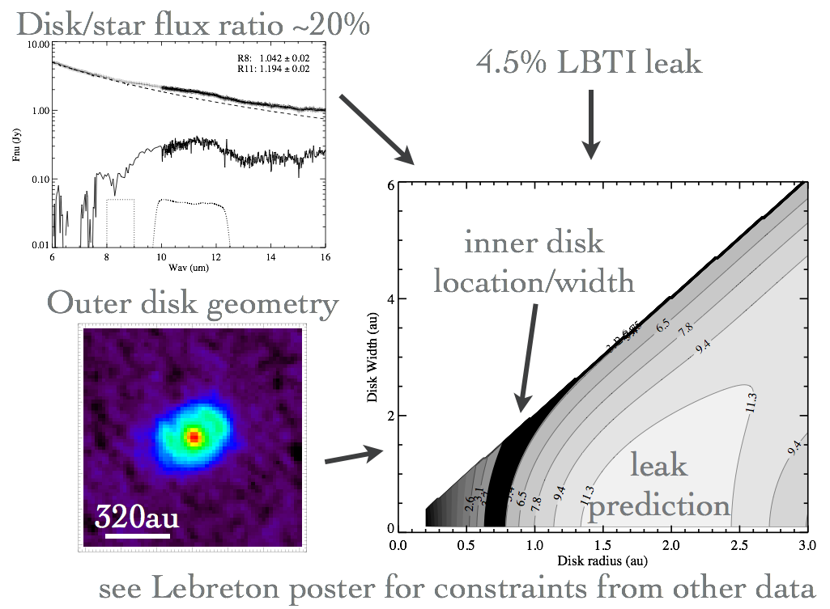
Courtesy G. Kennedy

Slide 44
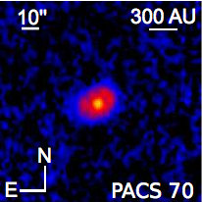
Our first detection: η Crv
3 hours of nulling observations in February 2014 around transit;
Outer disk seen by Herschel (i = 46.8°, PA = 116.3°, Duchene et al. 2014);
Excess: 17% (IRS), 4% (KIN);
Orientation of outer disk midplane
transit

Slide 45
η Crv best 5% of data

Slide 46
Transmission map for η Crv at 12:22 UT on 2/12/14
The inner contour indicates the dust sublimation radius while the outer contours show regions outside which a given ratio of the disk total flux is emitted, assuming the same disk inclination and position angle as the outer belt
Notes:
Effective LBTI sky transmission map at 11.1 m, when observing eta Crv at 12:22 UT on February 12, 2014 (Julian date: 2456700.5214, parallactic angle: 30:3). North is up, East is to the left. The inner contour indicates the dust sublimation radius while the outer contours show regions outside which a given ratio of the disk total flux is emitted, assuming the same disk inclination and position angle as the outer belt. This shows that a signicant fraction of the disk flux is actually not transmitted toward the null output of the interferometer.

Slide 47
β Leo
Twilight
β Uma
Vega
Clouds
HD 69830
Twilight

Slide 48
Vega

Slide 49
Nuller performance status
Demonstrated null depth of ~1% with a stability in the 0.3-0.6% range
Data calibration accuracy of ~0.2%
Expect a factor 2 improvement from advanced data reduction techniques (see Mennesson’s talk on Friday)
Advanced control algorithms for phase control under study

Slide 50
LBTI Performance Requirements
Identifier | Metric | Requirement | Tracking Metric | Impact | Current Status
T1 | Telescope Vibration | Disturb Null by <10⁻⁴ | Monitor vibration on critical optics | Increased zody limit | Telescope subsystems are below vibration threshold.
T2 | Observing Efficiency | >50% open shutter time | Data provided by LBTO | Increased Observing Time | Single Aperture efficiency is 60% (Nov. 2011).
T3 | Telescope Background | <10% | MMT Comparison/Measure with LBTI | Increased Observing Time | Currently measured at 11% (May 2011)
A1 | AO System Wavefront error | <220 nm | Simulate/ MMT AO system as prototype | Increased zody limit | On-sky performance is 120 n m RMS
A2 | Residual Image Motion | <3 mas | Simulate/Prototype | Increased zody limit | RMS=4 mas, May 2012
L1 | Nulling Stability | <0.1%(MMT) | BLINC prototype | Increased zody limit | MMT/BLINC performance is <0.2%. Simulation shows acceptable stability
 |  | <0.01%(LBT) | BLINC->LBTI scaling is 8-17x
L2 | Null Depth | <0.1% | BLINC prototype | Increased zody limit | BLINC lab tests have shown 0.03%
L3 | Contrast Curve | 10⁻⁶ at 3 l/D | Clio prototype / LMIRCam | Increased planet limit | First light with LMIRCam shows performance at ~< 10⁻⁵ at 3 l/D
L4 | N Band Noise Level | 100 µJy | MIRAC prototype | Increased Observing Time | MMT sensitivity is consistent.
L5 | L band Noise Level | 2 µJy | Clio prototype | Increased Observing Time | Single Aperture is 4 µJy
L6 | Instrument Background | <2% | Clio/MIRAC prototype | Increased Observing Time | To be measured.
L7 | Throughput | >0.2 | Clio/MIRAC prototype | Increased Observing Time | To be measured.
Green = Requirement Satisfied
Yellow = Requirement has been measured, but not met.
Blue = Requirement has not been measured.
Red = Worse Constraint
Brown = Additional Time

Slide 51
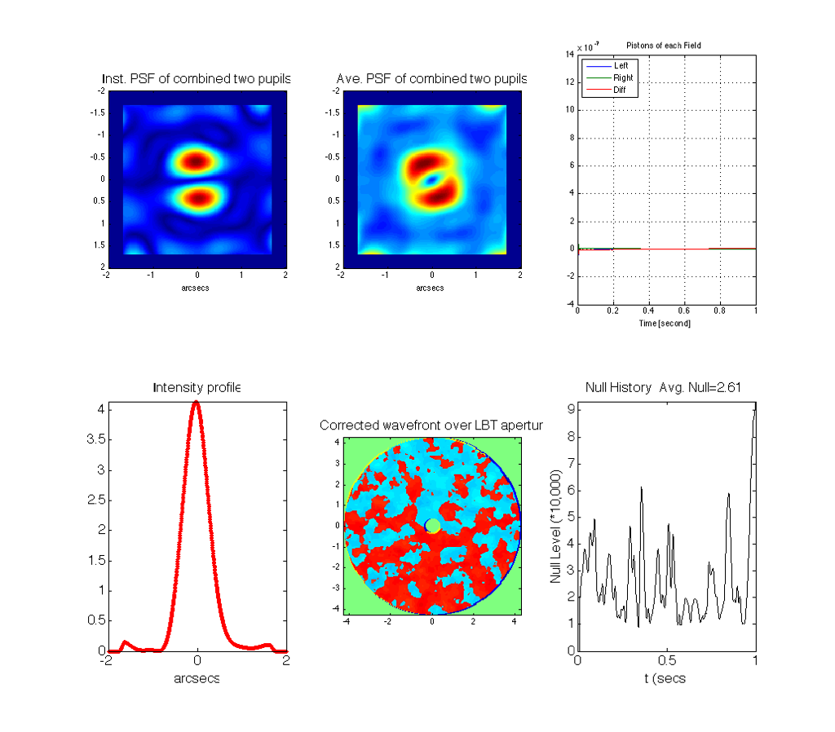
AO and Phasing Simulation
Matlab-based Monte Carlo AO code is being used to simulate nulling performance.
Null stability is seen to be ~5x10⁻⁵ for 30% variation in seeing between science object and PSF. This corresponds to approximately 3 zodies.
Suggests careful (and frequent) calibration procedures will be important.

Slide 52
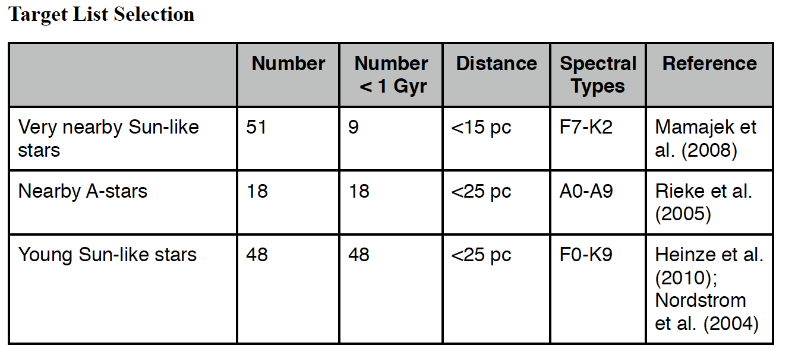
Preliminary HOSTS-LEECH Sample
Median:
Age: 1 Gyr
spectral type: G5
distance: 12 pc

Slide 53
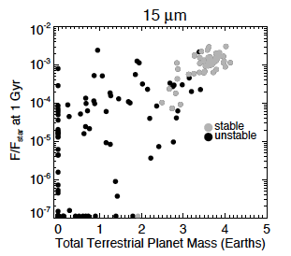
Dust Detection: What might we expect?
Raymond et al. (2011) have carried out an N body simulation of debris disks that predicts dust brightness as a function of final planet architecture.
Results suggest that systems with stable giant planets will have bright debris disks.
LBTI limit
LBTI can test these (and similar) predictions to lower risk in planning future exoplanet missions.
53

