Slide 1
Unturned Stones
A documentary film on Charles and Frances Townes by Taran Singh

Slide 2
Thank you
To Charles, Frances and their whole family
To the organizing committee for putting this important conference together
To the many friends old and new who have helped me learn about Charles and Frances and pushed this film to greater heights

Slide 3
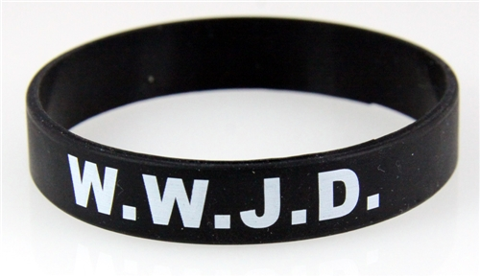
What would Jesus do?

Slide 4
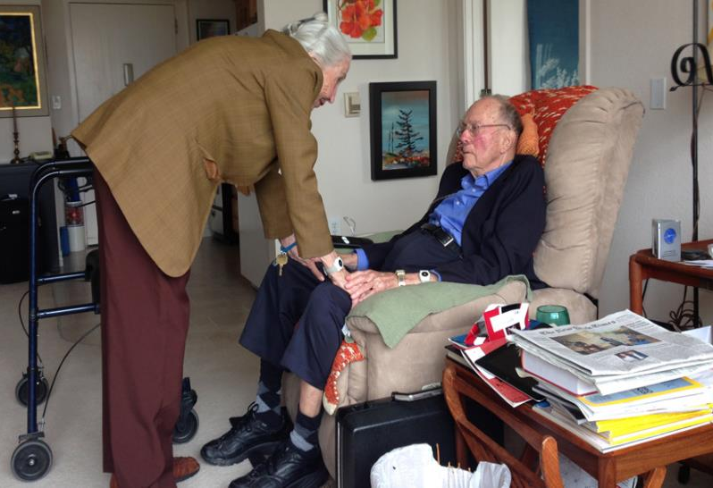
What would Charlie do?

Slide 5
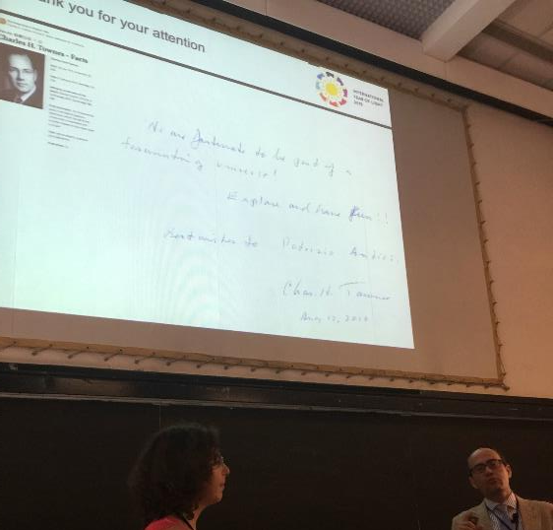
2015
Paris kickoff
International Year of Light and Light-based Technologies

Slide 6
What is Unturned Stones?
A feature-length (90+ minutes) documentary film on Charles and Frances Townes
Like any good film there is a strong love story
73 year marriage, 4 daughters, grandkids, great-grandkids. Married from 1941-2015
Devotion and sacrifice
Another important aspect of the story is that Charles sought to understand our universe and did so through science and religion
What he concluded was that science and religion indicate man has a special role in the universe

Slide 7
How did I get involved?
I was a student at Berkeley and over three years ago I found out Charles invented the laser. What an accomplishment—so I asked for an office hours
He patiently answered my questions and I left
A few weeks later I saw him after the Oppenheimer lecture and asked him a few questions again. This time he had a question: Can I give him a ride home?
My answer was yes because I had a car and the time to help a man who has helped the world so much
This turned into three years of driving him to and from his home and campus on a daily basis

Slide 8
Getting ticketed in the car
Ironic stuff

Slide 9
Why make a film?
I was familiar with film from producing documentary clips with climate, energy and environmental experts at Berkeley
I quickly realized Charles deserves a full documentary because of the laser and his love of life and Earth
Filmmaking is a great way to influence and educate the public, and digital technology has made it more accessible to everyone
“I have always been motivated not by something inside me that needed to be expressed but rather by the wonder of something I see that I want to share with the rest of the world. I think of myself as a chronicler of my time and feel impelled to probe and probe into the depths of society in search of the essence of the truth.”
      --Jack Delano, documentary photographer

Slide 10
Production timeline and funding
I started filming and researching 3.5 years ago
Collected dozens of hours of footage with Charles and Frances in a variety of settings, including their apartment home, church, UC Berkeley offices, and birdwatching
Also filmed interviews with colleagues like Walt Fitelson, Ed Wishnow, Dan Werthimer, Arno Penzias, and Reinhard Genzel
Most funding so far has come from me and my family, and some from Spectra Physics and South Carolina State Museum
Production is stopped currently because of no money
Interviews waiting to happen include Freeman Dyson, Vint Cerf, Norio Kaifu, Elsa Garmire, and an important one with Frances

Slide 11

Unturned Stones Trailer

Slide 12
What can Unturned Stones do?
Heal some of the rift between the scientific and religious camps and offer a new path
Increase funding and the talent available to science
Help religious communities navigate a world increasingly dominated by science and technology
Example: Home-school group is 1.8m people in U.S.
The film will spread Charles and Frances’ legacy forever across the world. Digital media doesn’t disappear
Example: 1,000 years in the future someone interested in the documentary on the inventor of the laser watches Unturned Stones

Slide 13
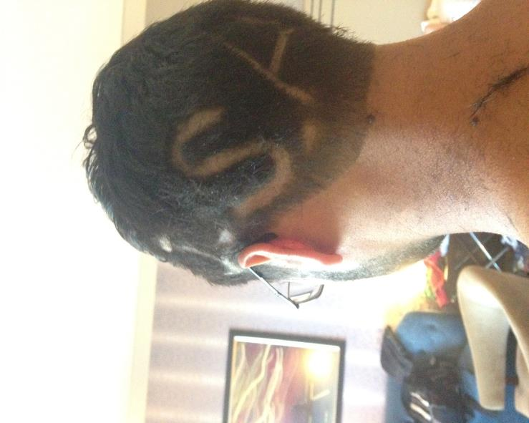
What would Charlie have thought?

