Slide 1

CHT: Clock Hardware for Timekeeping
Demetrios Matsakis (USNO)
Lasers, Light, and Legacy
August 1, 2015
Berkeley, CA

Slide 2
Clockmaking’s success had 100’s of fathers
some called Plato, Galileo, Kelvin, Maxwell, Rabi
and several were called Charlie
1945 - Townes writes memo to Bell Labs on atomic clocks
  refers to “everybody talking about it”
1949 – NBS (NIST) builds ammonia-based clock
  Townes is consultant
1953 – Townes invents maser, with obvious timekeeping possibilities
1955 – Louis Essen (NPL) builds practical cesium clock
1974 – Vessot develops hydrogen-maser clocks
Today – Masers are the most precise clocks money can buy
  USNO has 47 cavity-tuned maser clocks @ $250,000 each
  Frequency precisions ~ 10 ⁻¹⁵

Slide 3
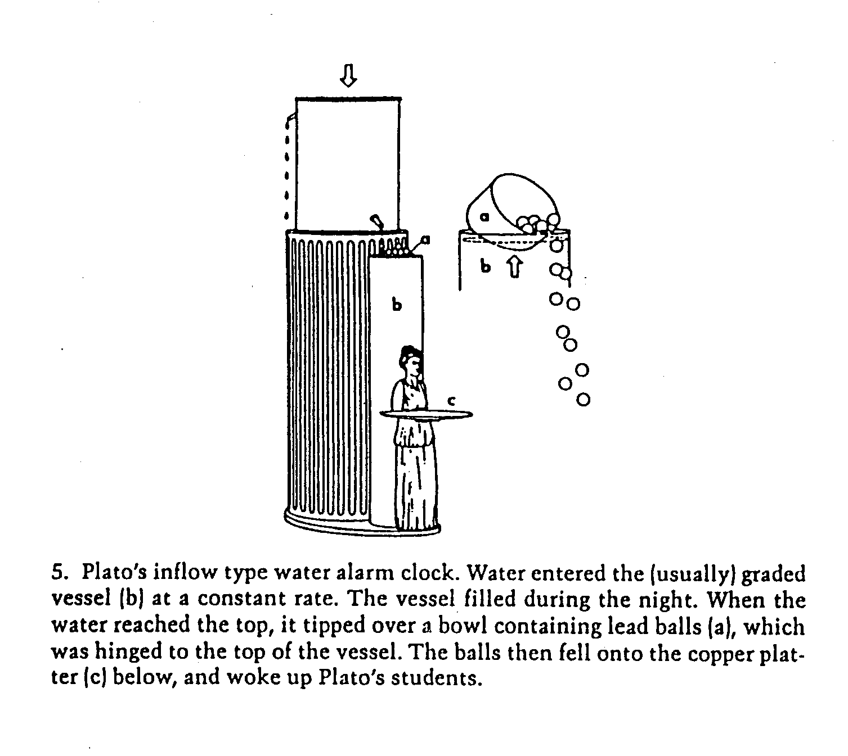
Plato’s Water-Powered Alarm Clock
Source: J. Barnett, Time’s Pendulum, Plenum Press

Slide 4
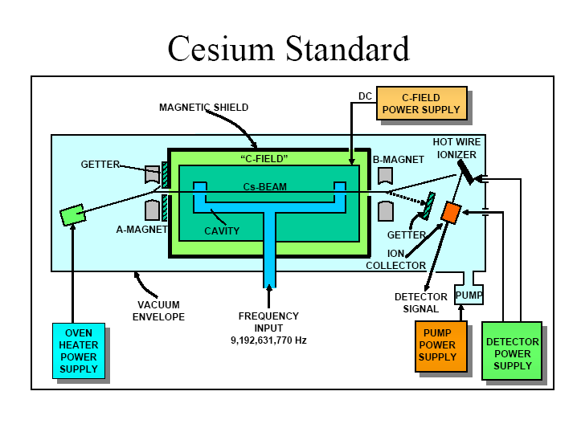
Source: John Vig
4

Slide 5
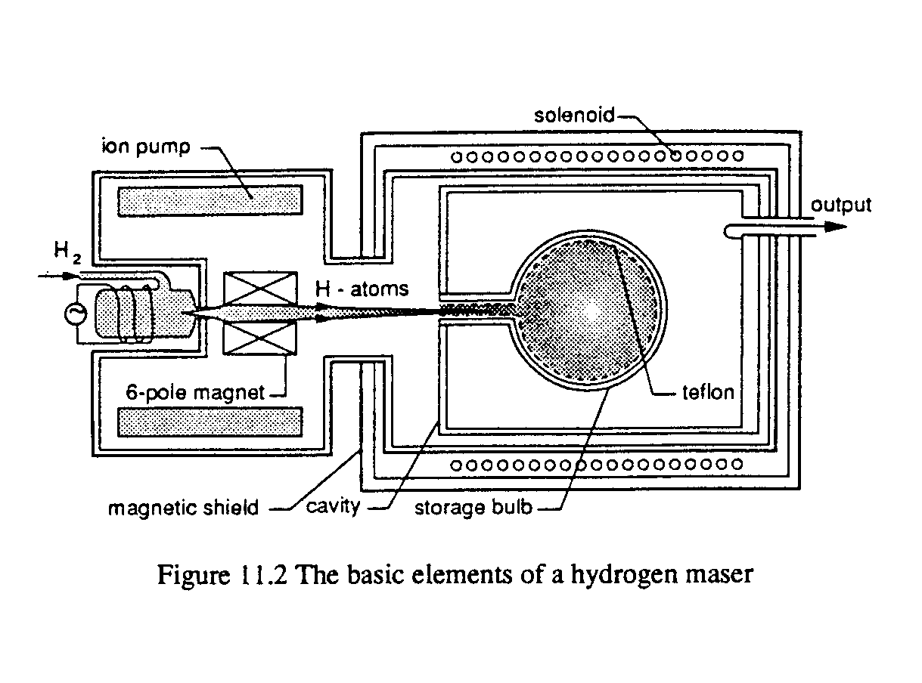
Hydrogen Maser Frequency Standard
F.G. Major Springer, “The Quantum Beat”, 1998
5

Slide 6
Manipulating Atoms With Lasers
Laser in one dimension exerts a scattering force on atoms in the direction of the laser
Lasers in two dimensions, red detuned, exert a velocity-sensitive force on the atoms
Atoms can be brought to zero average velocity, with very little residual motion (i.e. cold)
(Source: Tom Swanson, USNO )

Slide 7
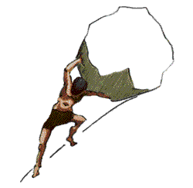
Sisyphus Effect
Ref: Encyclopedia of Greek Mythology http://www.mythweb.com/encyc/gallery/sisyphus_c.html

Slide 8
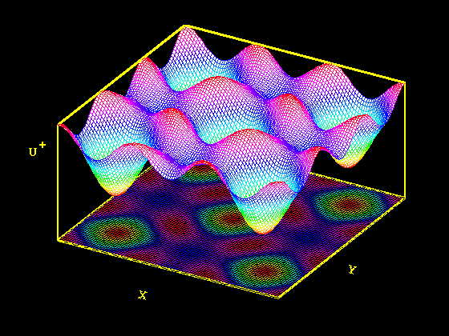
Potential Field of a Ground State Sublevel of an Atomic Ground State in an Optical Polarization Gradient
Ref: http://www.physics.helsinki.fi/~jpiilo/coolpr.html

Slide 9
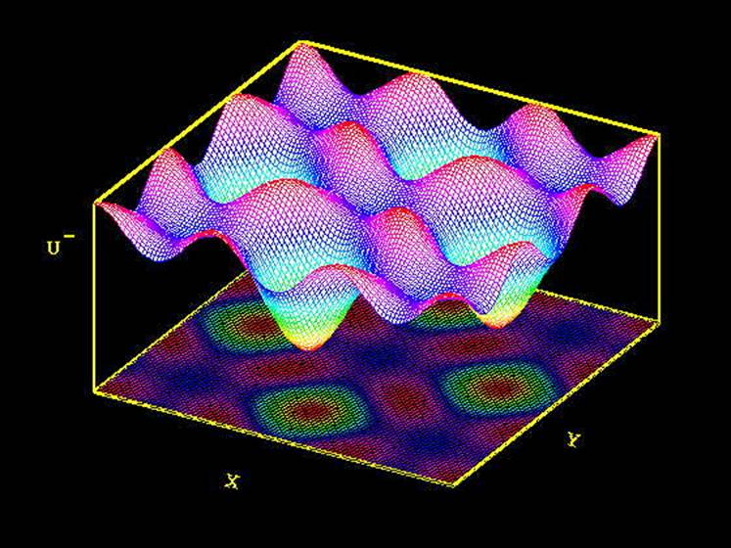
Potential Field of a Different Sublevel
Ref: http://www.physics.helsinki.fi/~jpiilo/coolpr.html

Slide 10
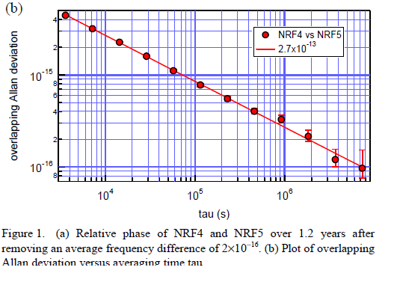
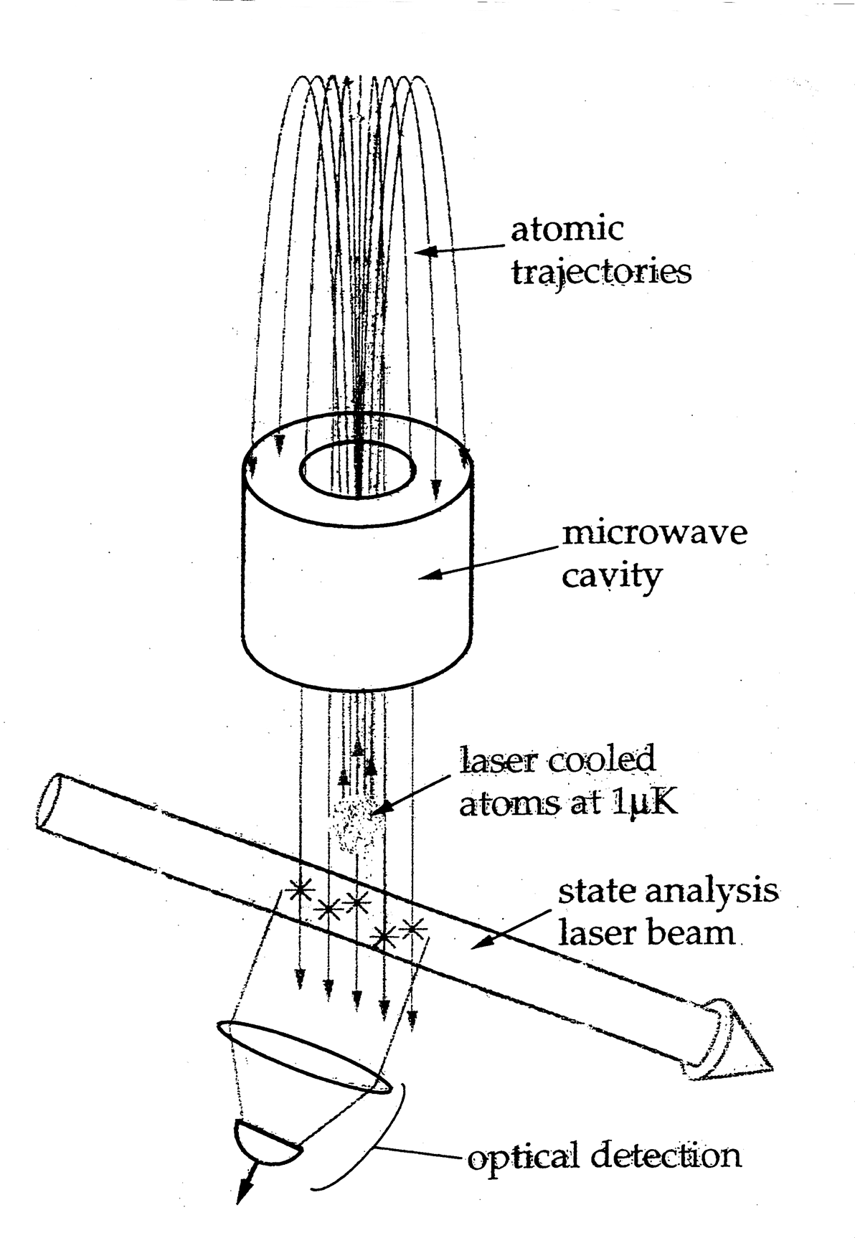
The Cesium/Rubidium Fountain
Source: Chris Ekstrom

Slide 11
Promise of Optical Standards
σ = (Δf /f)/(SNR)/Sqrt(τ)
Where
σ = frequency stability
Δf =width of Ramsey fringe
f =frequency of the transition
SNR = measurement Signal to Noise Ratio
τ = integration time

Slide 12
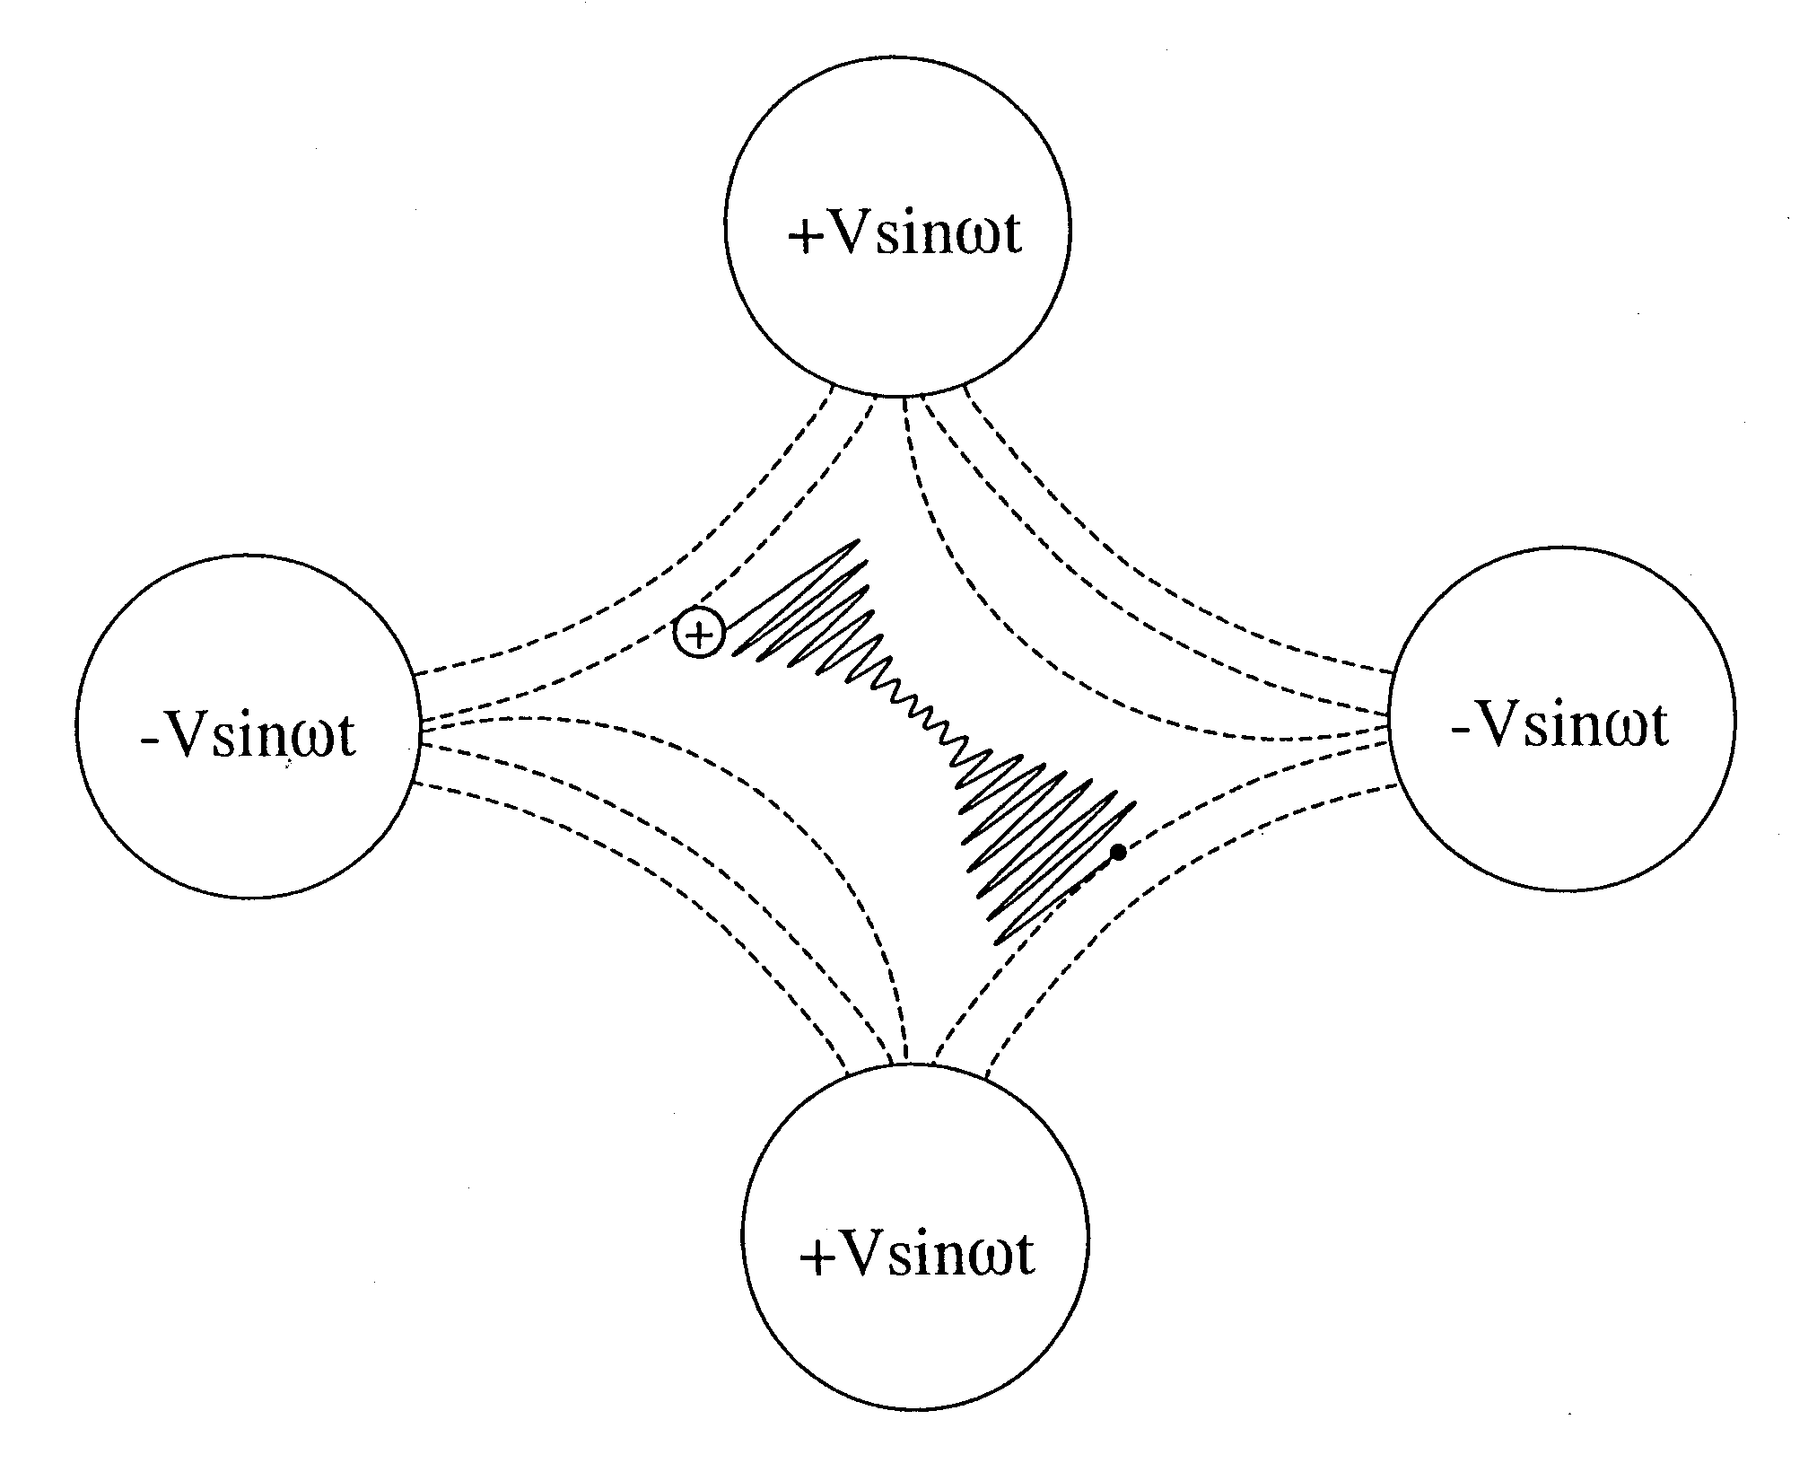
Ion Trapped In
Quadrupole Force Field
Source: Dr. Demetrios Matsakis

Slide 13

Individual Ions in NIST’s Ion Trap
(Gaps are position of different Hg isotope)

Slide 14
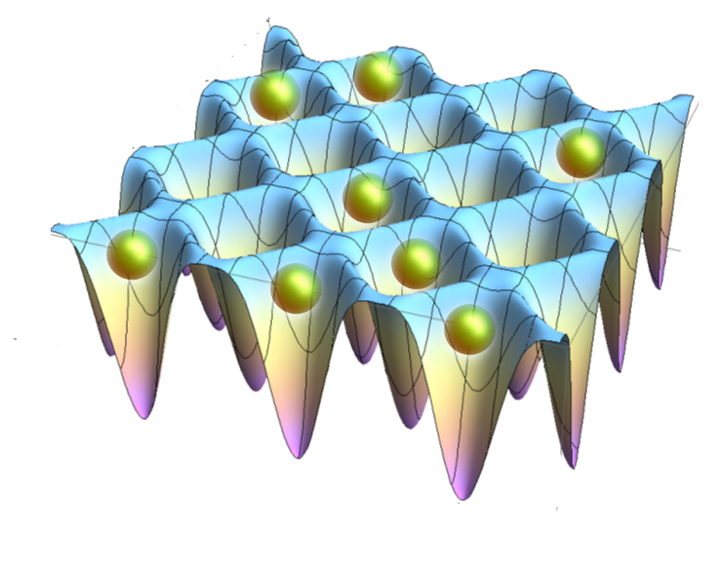
Feb 2015: Japanese achieve 2 10⁻¹⁸ stability!
(with strontium at “magic wavelength” of zero light shift)
http://phys.org/news/2015-02-centimeter-cryogenic-clocks-pave.html

Slide 15
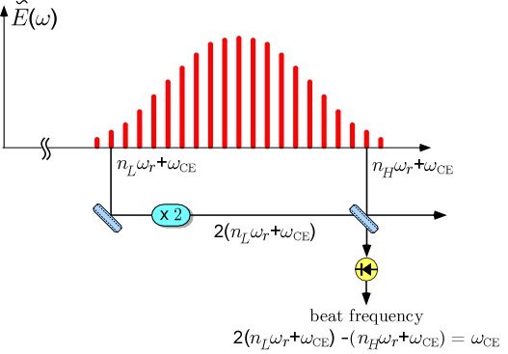
Definitely 21st Century: Optical Comb
Translates Optical Frequencies to Microwave
Clock Precisions => 10 ⁻¹⁸
Ref: http://www.mpq.mpg.de/~haensch/comb/research/combs.html

Slide 16
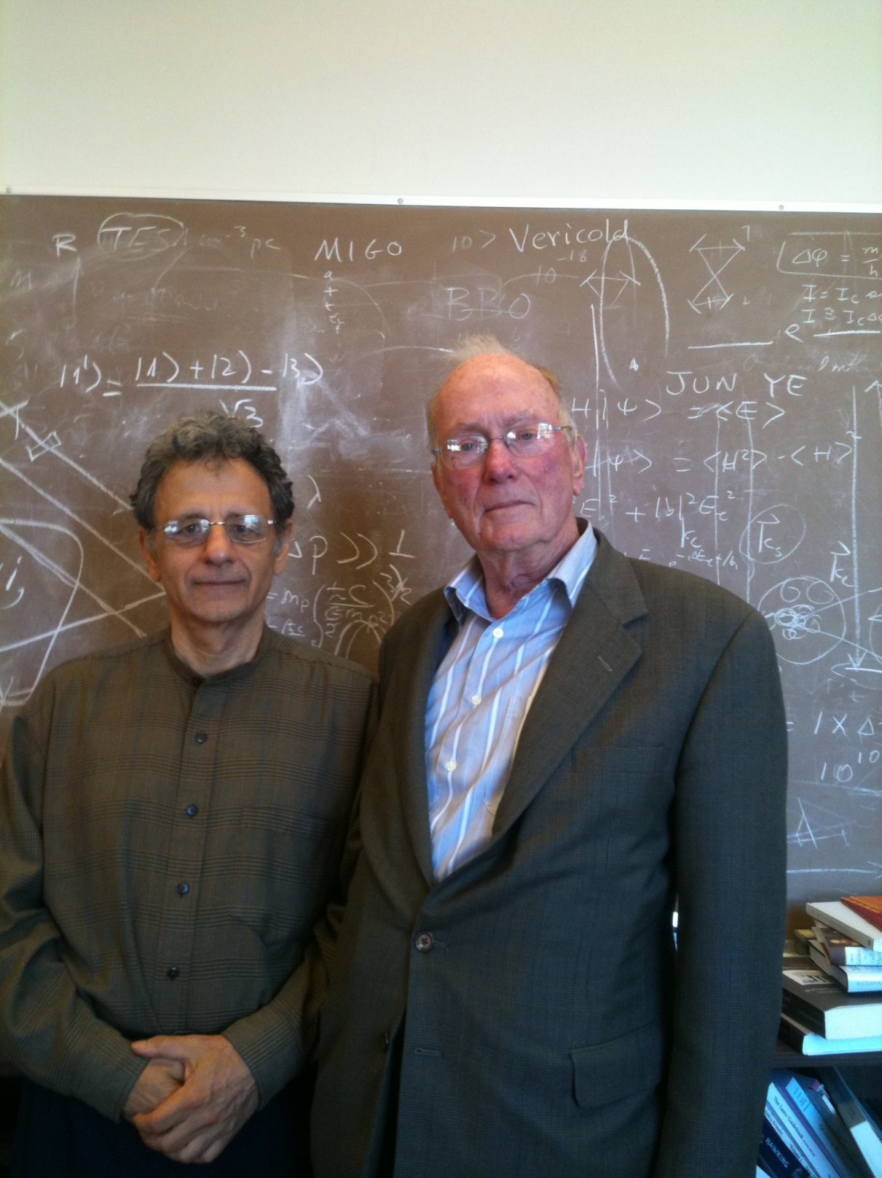
but in 2011 …

Slide 17
Backups

Slide 18
UTC Today
Each month:
72 participants (April 2013)
~400 atomic clocks
Ceasiums, Masers
+ 4 Rb Fountains
~12 primary frequency standards
(mostly Cs fountains)
~250 time transfer files
daily, weekly, (monthly)
Monthly (post-processed)
Provides UTC through values of [UTC-UTC(k)] at 5-day intervals
[UTC-UTC(k)] between 2 ns – some ms / uncertainty 5 ns – 20 ns
BIPM Circular T
Weekly
Values of [UTCr-UTC(k)] at 1-day intervals
Rapid UTC

Slide 19
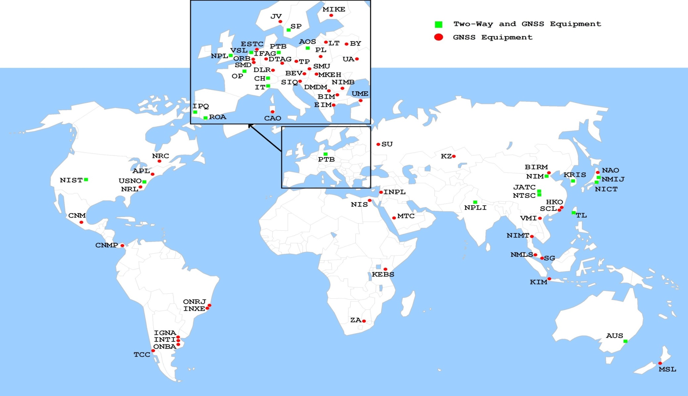
Time Knows No Borders
Participating laboratories and their time transfer equipment (2013)

Slide 20
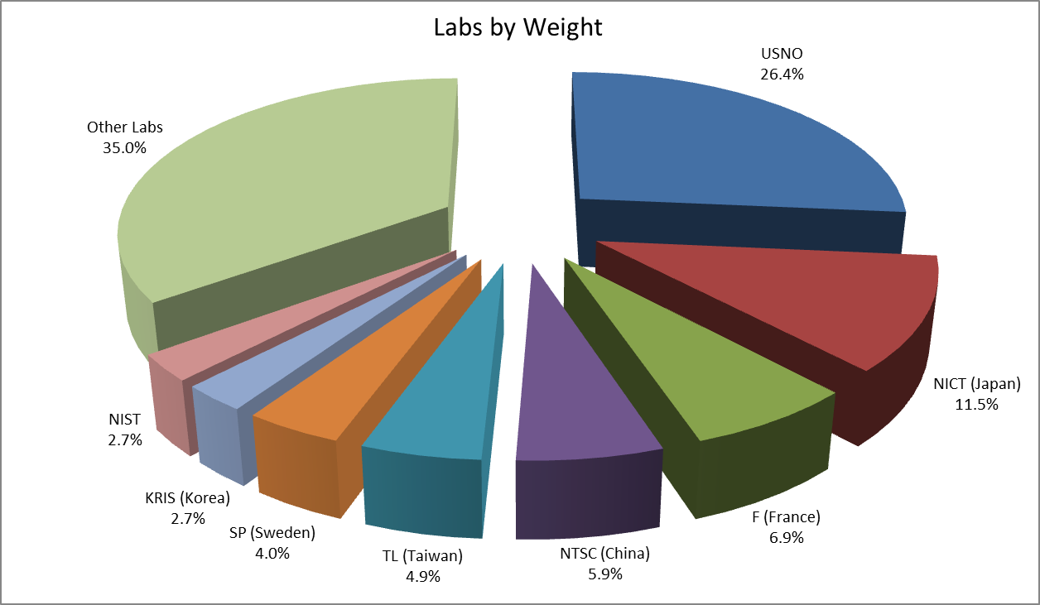
Everyone Gets To Play

Slide 21
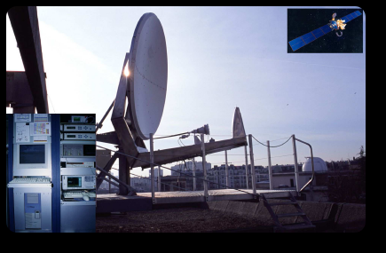
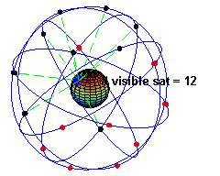
From Clock Labs to UTC: Time Transfer
Two-Way Satellite Time Transfer (TWSTT)
  Utilizes geostationary satellite
Global Navigation Satellite Systems (GNSS)
  GPS
  GLONASS
  Galileo on the way
  More?

Slide 22
Clock Precisions Today
(deviations from long-term model of rate, drift)
Averaging Time | Best Cesium Beam Clocks | Best Masers “given their personalities” | Rubidium Fountains
1 hour | 500 ps | 40 times better than cesium | 25 times better than a Cesium
1 day | 2.5 ns | 30 times better than a cesium | 25 times better than a cesium
40 days | 15 ns | 3 times better than a cesium | 25 times better than a cesium
80 days | >25 ns | Slightly better than a cesium | >25 times better than a cesium

Slide 23
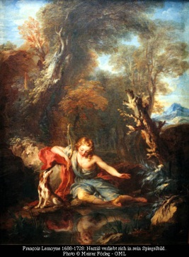
UTC/EAL’s Algorithm
  Simple, robust clock model
    Optimal for driftless clocks, white phase noise
    Based on extrapolations/predictions of Clock-TT
      TT = Terrestrial Time
      TT = post-processed “UTC without leapseconds”
  UTC set so average deviation of clocks from model is zero
  Each clock weighted by monthly frequency stability
    Very democratic
      Not Narcissistic
      Maximum weight ensures robustness
        See Petit, Metrologia, 2003, 40 No3 252-256
  Algorithm has steady record of incremental improvements

Slide 24
The Quality of TAI/UTC
Frequency stability ~3 x 10⁻¹⁶ @ 40 d
Clock frequency prediction
Clock weighting
Frequency accuracy ~3 x 10⁻¹⁶
Frequency correction to match the SI second
Based on PFS data
Stability of EAL using the USNO Rb fountain as independent reference

Slide 25
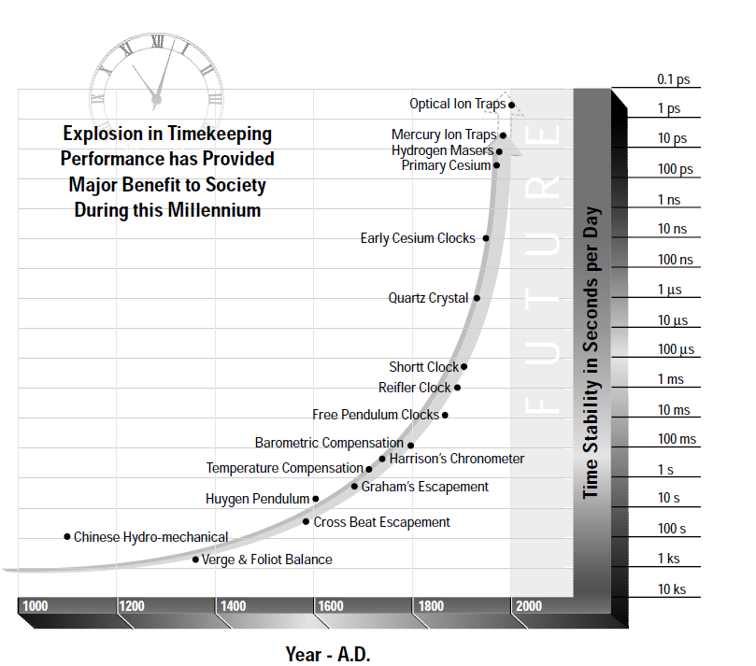
Clock Making’s Exciting History

Slide 26
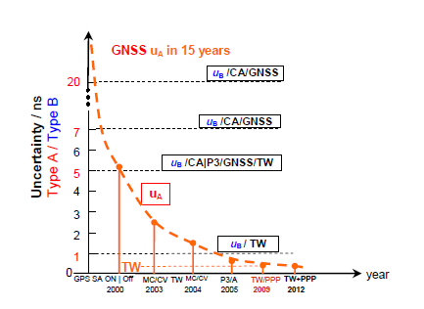
Time Transfer Noise’s Bleak Future
Operational by 2020
Multiple & Redundant GNSS
Fiber Optic ?
VLBI ??
Carrier Phase TWSTT ???

Slide 27
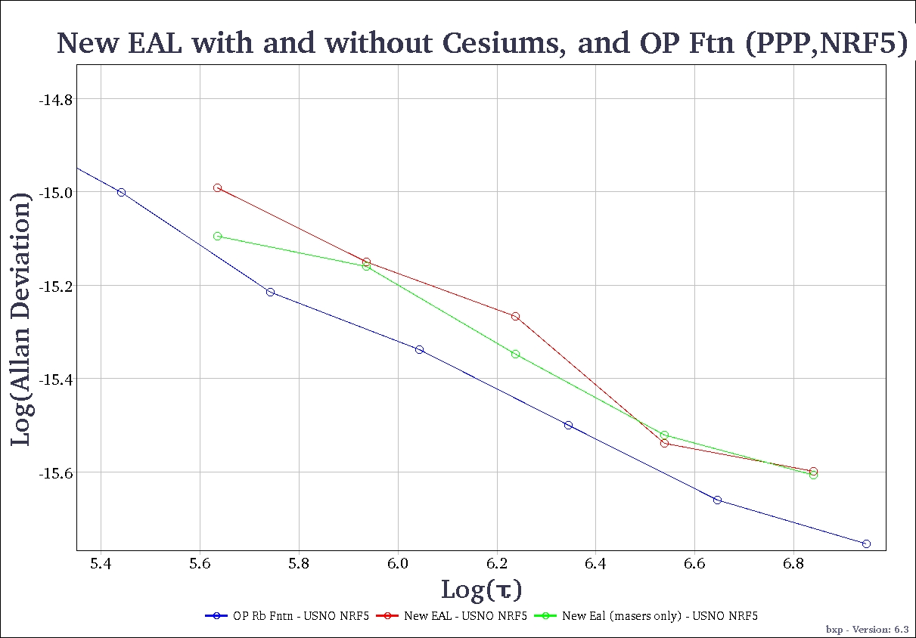
Prediction: the Bottom Line Will Get Lower

Slide 28
UTC in 2020
More and Better Clocks
  1000 clocks from 100 nations
More and Better Primary Frequency Standards
  Optical frequency standards in ~ 10 laboratories
Improved Time Transfer
  Robust at 250 ps RMS
Improved Algorithms for UTC
  Fully utilizing the complementary clock characteristics
Daily delivery of UTC
  Improved real-time realizations of UTC by participating laboratories, UTC(k) as in UTC(USNO) and UTC(NPL)
  Precise steering of GNSS times to a representation of UTC
UTC for User: Precise and Accurate to 500 ps RMS
  Rarely erroneous by > 1 ns

Slide 29
Primary frequency standards
Primary frequency standards – 13 in the last five years (KRISS, INRIM, LNE-SYRTE, NICT, NIST, NMIJ, NPL, PTB), 11 are Cs fountains

Slide 30
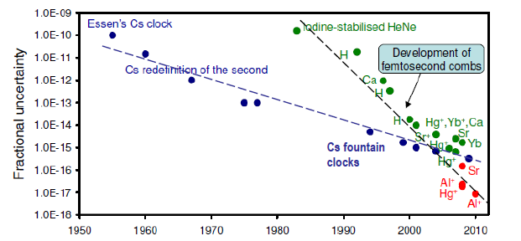
From microwaves to optical frequencies
Microwave clocks (Cs fountains) realizing the SI second with uncertainty of order 10⁻¹⁵-10⁻¹⁶
Optical clocks (neutral atoms, ions) representing the SI second with uncertainty of order 10⁻¹⁷- 10⁻¹⁸

